Slide 1
SLIENT SOUND TECHNOLOGY
Submitted by: Manoj Jadav
Exam No: 2019065903
Guided by :
Prof.Bhumika Patel
Exam No:2019065903
1

Slide 2
content
Introduction
How we speak…?
What it is ?
Need for silent sound ?
Origination
Methods…
Applications
Advantage
Disadvantage
Future prospects
Conclusion
References
2
Exam No:2019065903

Slide 3
INTRODUCTION
The word Cell Phone has become greatest buzz word in Cellular Communication industry.
There are lots and lots of technology that tries to reduce the Noise pollution and make the environment a better place to live in.
I will tell about a new technology known as Silent Sound Technology that will put an end to Noise pollution.
3
Exam No:2019065903

Slide 4
INTRODUCTION(con..)
In the 2010 CeBIT's "future park", a concept "Silent Sound" Technology demonstrated which aims to notice every movement of the lips and transform them into sounds, which could help people who lose voices to speak, and allow people to make silent calls without bothering others.
the device, developed by the Karlsruhe Institute of Technology (KIT), uses electromyography, monitoring tiny muscular movements that occur when we speak and converting them into electrical pulses that can then be turned into speech, without a sound uttered.
4
Exam No:2019065903

Slide 5
What it is……..?
It is a technology that helps you to transmit information without using your vocal cords.
This technology aims to notice lip movements & transform them into a computer generated sound that can be transmitted over a phone.
Hence person on other end of phone receives the information in audio.
they can be immediately transformed into the language of the user’s choice.
“Native speakers can silently utter a sentence in their language, and the receivers hear the translated sentence in their language.
5
Exam No:2019065903

Slide 6
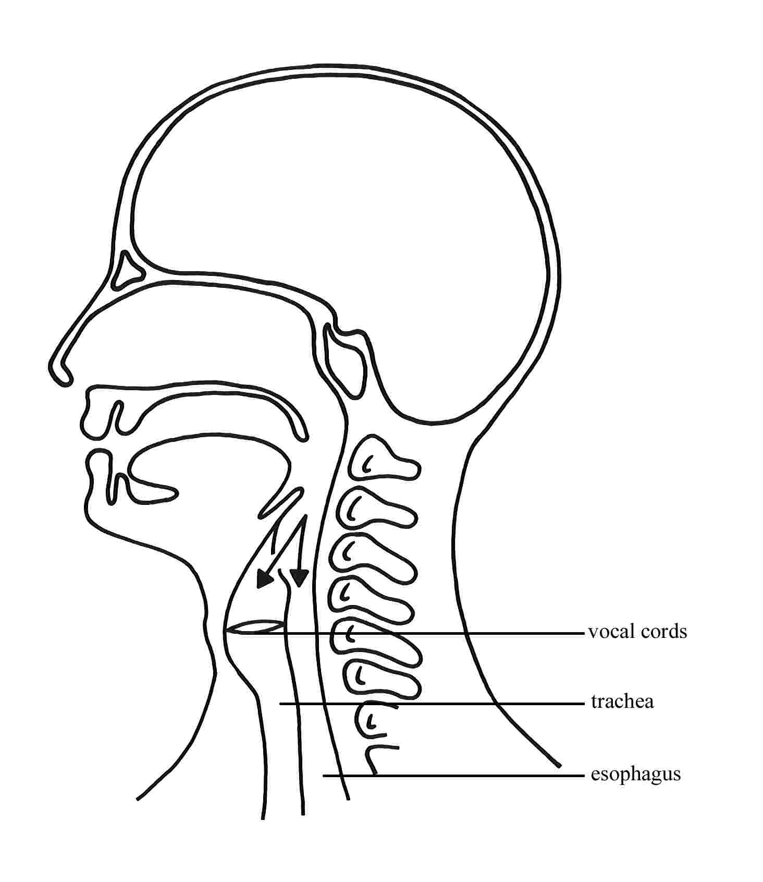
HOW WE SPEAK……….?
When we generally speak a loud, air passes through larynx & the tongue.
Words are produced using articulator muscle in the mouth & jaw region.
[Figure 1 Speaking Process in human body ]
6
Exam No:2019065903

Slide 7
HOW WE SPEAK……….?(con..)
Now imagine a technology that could allow everyone to make phone calls, and talk, without making a sound….. Serene, peaceful & heavenly.
Even by saying words without producing sound, weak electric currents are sent from your brain to the speech muscle.
These electrical signals are known as ELECTROMYOGRAMS and its study is called as Electromyography.
7
Exam No:2019065903

Slide 8

NEED FOR SILENT SOUND
Silent Sound Technology will put an end to embarrassed situation such as-
An person answering his silent, but vibrating cell phone in a meeting, lecture or performance, and whispering loudly, ‘ I can’t talk to you right now’ .
In the case of an urgent call, apologetically rushing out of the room in order to answer or call the person back.
[Figure 2 make phone call in office or crowd place ]
8
Exam No:2019065903

Slide 9
ORIGINATION
Humans are capable of producing and understanding whispered speech in quiet environments at remarkably low signal levels.
The idea of interpreting silent speech electronically or with a computer has been around for a long time, and was popularized in the 1968 Stanley Kubrick science-fiction film ‘‘2001 – A Space Odyssey ”.
9
Exam No:2019065903

Slide 10
Methods…
Silent Sound Technology is processed through some ways or methods. They are
Electromyograpy(EMG)
Image Processing
10
Exam No:2019065903

Slide 11
ELECTROMYOGRAPHY…
It is a technique which monitors tiny muscular movements and pulses generated by it . The transducers involved converts the pulses into electric signals.
Electromyographic sensors attached to the face records the electric signals produced by the facial muscles, compare them with pre recorded signal pattern of spoken words
11
Exam No:2019065903

Slide 12
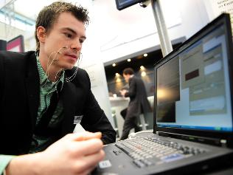
ELECTROMYOGRAPHY…(con..)
When there is a match that sound is transmitted on to the other end of the line and person at the other end listen to the spoken words
[Figure 3 sensors attach with face]
12
Exam No:2019065903

Slide 13
ELECTROMYOGRAPHY…(con..)
Electromyography (EMG) is a technique for evaluating and recording the electrical activity produced by skeletal muscles.
An electromyography detects the electrical potential generated by muscle cells, when these cells are electrically or neurologically activated.
13
Exam No:2019065903

Slide 14
Working of Electromyography
A needle containing two fine-wired electrodes is inserted through the skin into the muscle tissue.
Normal muscles at rest make certain, normal electrical sounds when the needle is inserted into them. Then the electrical activity when the muscle is at rest is observed.
Each electrode track gives only a very local picture of the activity of the whole muscle. Because skeletal muscles differ in the inner structure, the electrode has to be placed at various locations to obtain an accurate signal.
Thus by this way the speech can be communicated without sound.
14
Exam No:2019065903

Slide 15
Image processing
The simplest form of digital image processing converts the digital data type into a film image with minimum corrections and calibrations.
In electrical engineering and computer science, image processing is any form of signal processing for which the input is an image, such as a photograph or video frame; the output of image processing may be either an image or, a set of characteristics or parameters related to the image
Most image-processing techniques involve treating the image as a two-dimensional signal and applying standard signal-processing techniques to it.
15
Exam No:2019065903

Slide 16
[Figure 4 Working methodology]
16
Exam No:2019065903

Slide 17
Image processing(con..)
Image processing are two types as
Analog image processing
Digital image processing.
17
Exam No:2019065903

Slide 18
APPLICATIONS
Silent Sound Technology is applied in military for communicating secret/confidential matters to others.
As we know in Space there is no media for sound to travel therefore this technology can be best utilized by astronauts.
Since the electrical signals are universal they can be translated into any language. Native speaker can translate it before sending it to other side. Hence it can be converted into any languages of choice currently being German, English, & French.
18
Exam No:2019065903

Slide 19
ADVANTAGES
Helping people who have lost their voice due to illness or accident.
This technology helps to transmit information without using vocal cords.
Who are suffering from Aphasia (Speaking Disorder).
We can make silent calls even if we are standing in crowded place.
Very good technology for noise cancellation technique.
Very useful for sharing confidential information like secrete PIN number on cell phone at public place.
19

Slide 20
disadvantages
This device presently needs nine leads to be attached to our face which is quite impractical to make it usable.
This technology will be very costly for a common man
Even differentiating between people and emotions cannot be done. This means you will always feel you are talking to a robot.
Translation into majority of languages but for languages such as Chinese different tone holds different meaning, facial movements being the same. Hence this technology is difficult to apply in such situations.
20
Exam No:2019065903

Slide 21
Future prospects
Silent Sound Technology gives a bright future to speech recognition technology from simple voice commands to memorandum dictated over the phone all this fairly possible in noisy public places.
In Electromyography, without having electrodes and sensors hanging all around your face, these electrodes and sensors will incorporate in to cell phones.
Nano Technology will be a mentionable step towards device handy
21
Exam No:2019065903

Slide 22
CONCLUSION
Silent Sound Technology is one of the recent trends in the field of information technology implements “TALKING WITHOUT TALKING”.
It will be one of the innovation and useful technology and in mere future this technology will be used in our day to day life.
Silent Sound Technology aims to notice every movement of the lips and transforms them into sounds, which could help people who have lost their voice due to illness or accident, and allow the people to make silent calls without bothering others. Rather than making any sounds.
22
Exam No:2019065903

Slide 23
References
https://studymafia.org/silent-sound-technology-seminar-ppt-and-pdf-report/
https://studylib.net/doc/25548833/silent-sound-technology-ppt
23
Exam No:2019065903

Slide 24
Thank You
24
Exam No:2019065903

Slide 25


